Slide 1
CS 6381 Final Project
Apache Cassandra
James Vu | Craig Topham | Thomas Boudreau

Slide 2
References
Code, documentation, data, references, etc. at: https://github.com/jamesvu1/cs6381finalprojectapachecassandra
Disclaimer: This repository was completed based on our overall understanding of the experiment instructions and what we knew/found through our efforts/attempts given the time we have had.

Slide 3
Overview
Built a write-read type of app implementing Apache Cassandra and Python
Data flow:
cassandraRW.py
Writer argument: Insert length-specified strings of random characters into the database.
Reader argument: Select a record from the database.
Time is measured during each of these queries independently and saved into CSV.
calculateStatistics.py: Read the data from “timeDifferences” CSV files and save a CSV filled with statistics (e. g. min, max, average, standard deviation)
capAnalysis.py
Insert argument: Insert a record into the database based on a sample file index.
Update argument: Update a record in the database based on a sample file index.
Read argument: Select for a record in the database based on a sample file index.
Table.py: Create or drop table.
hardwareMeasure.py: Continuously see the latest hardware statistics (CPU, RAM, storage)

Slide 4
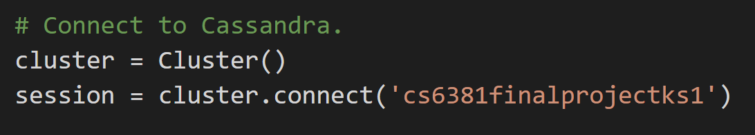
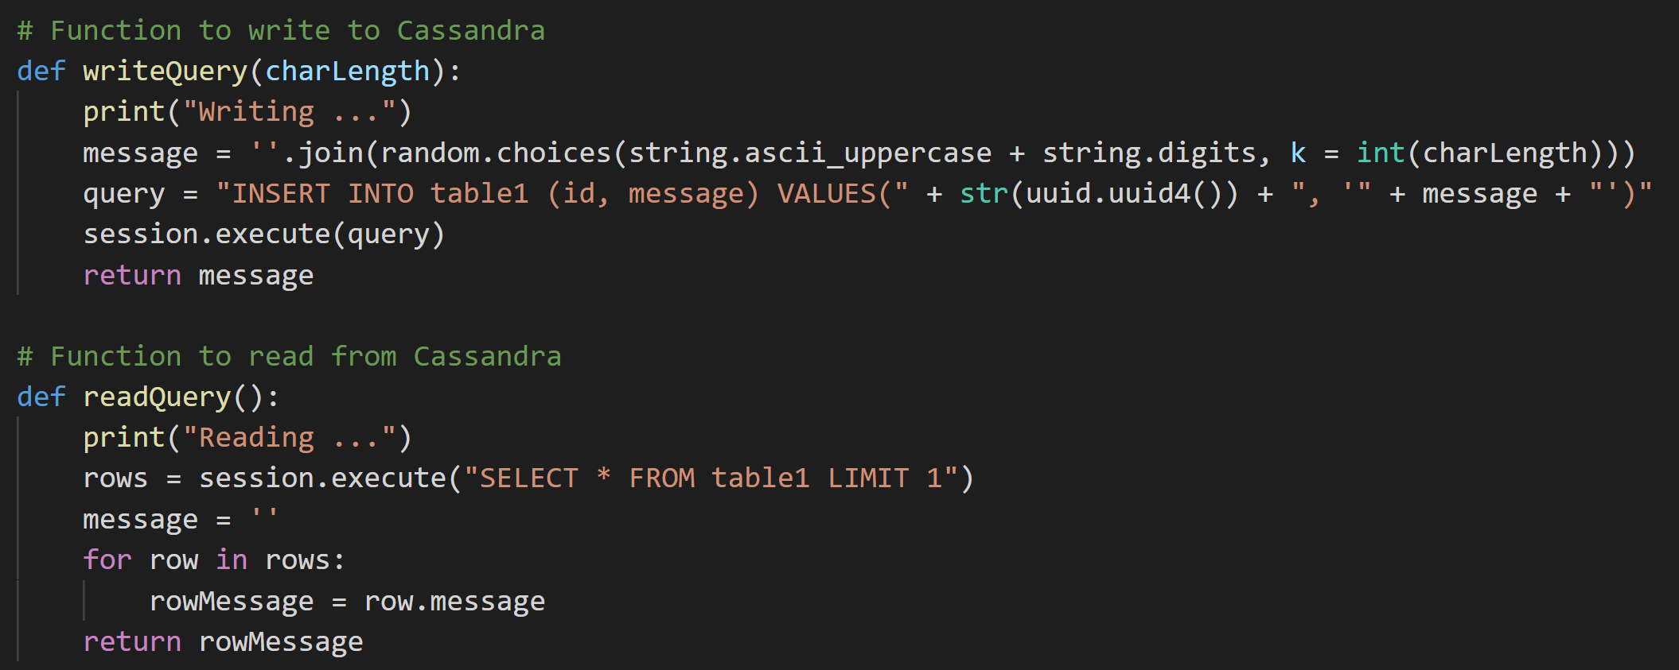
Code – cassandraRW.py

Slide 5
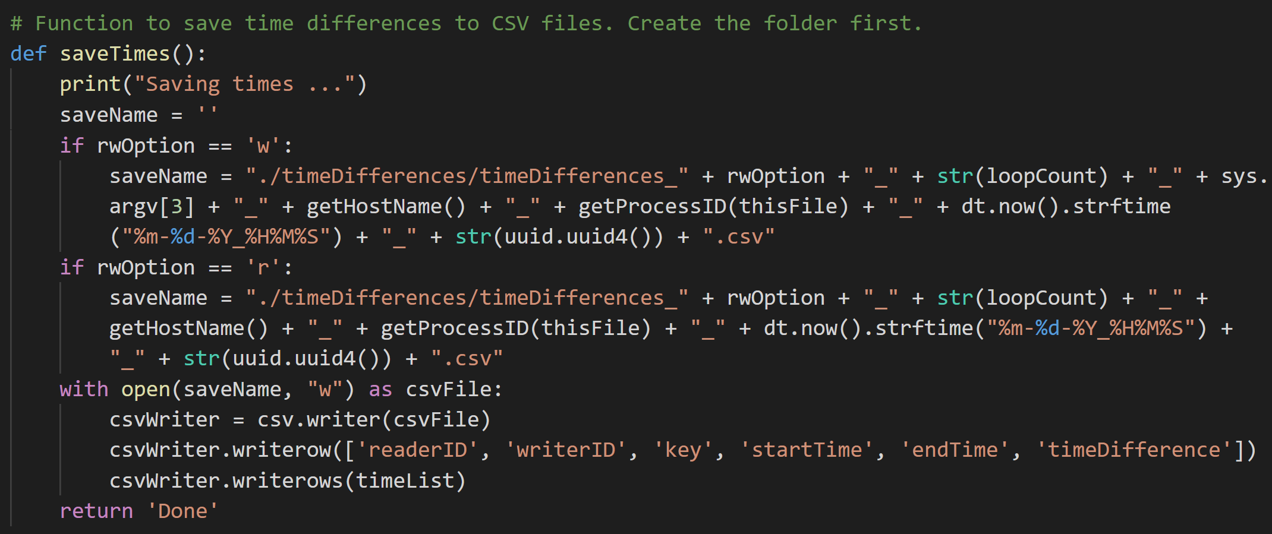
Code – cassandraRW.py

Slide 6
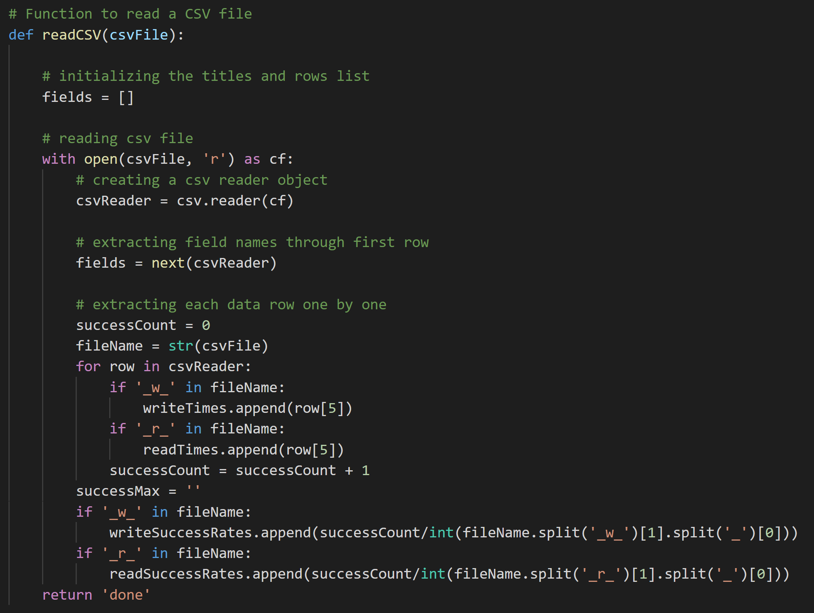
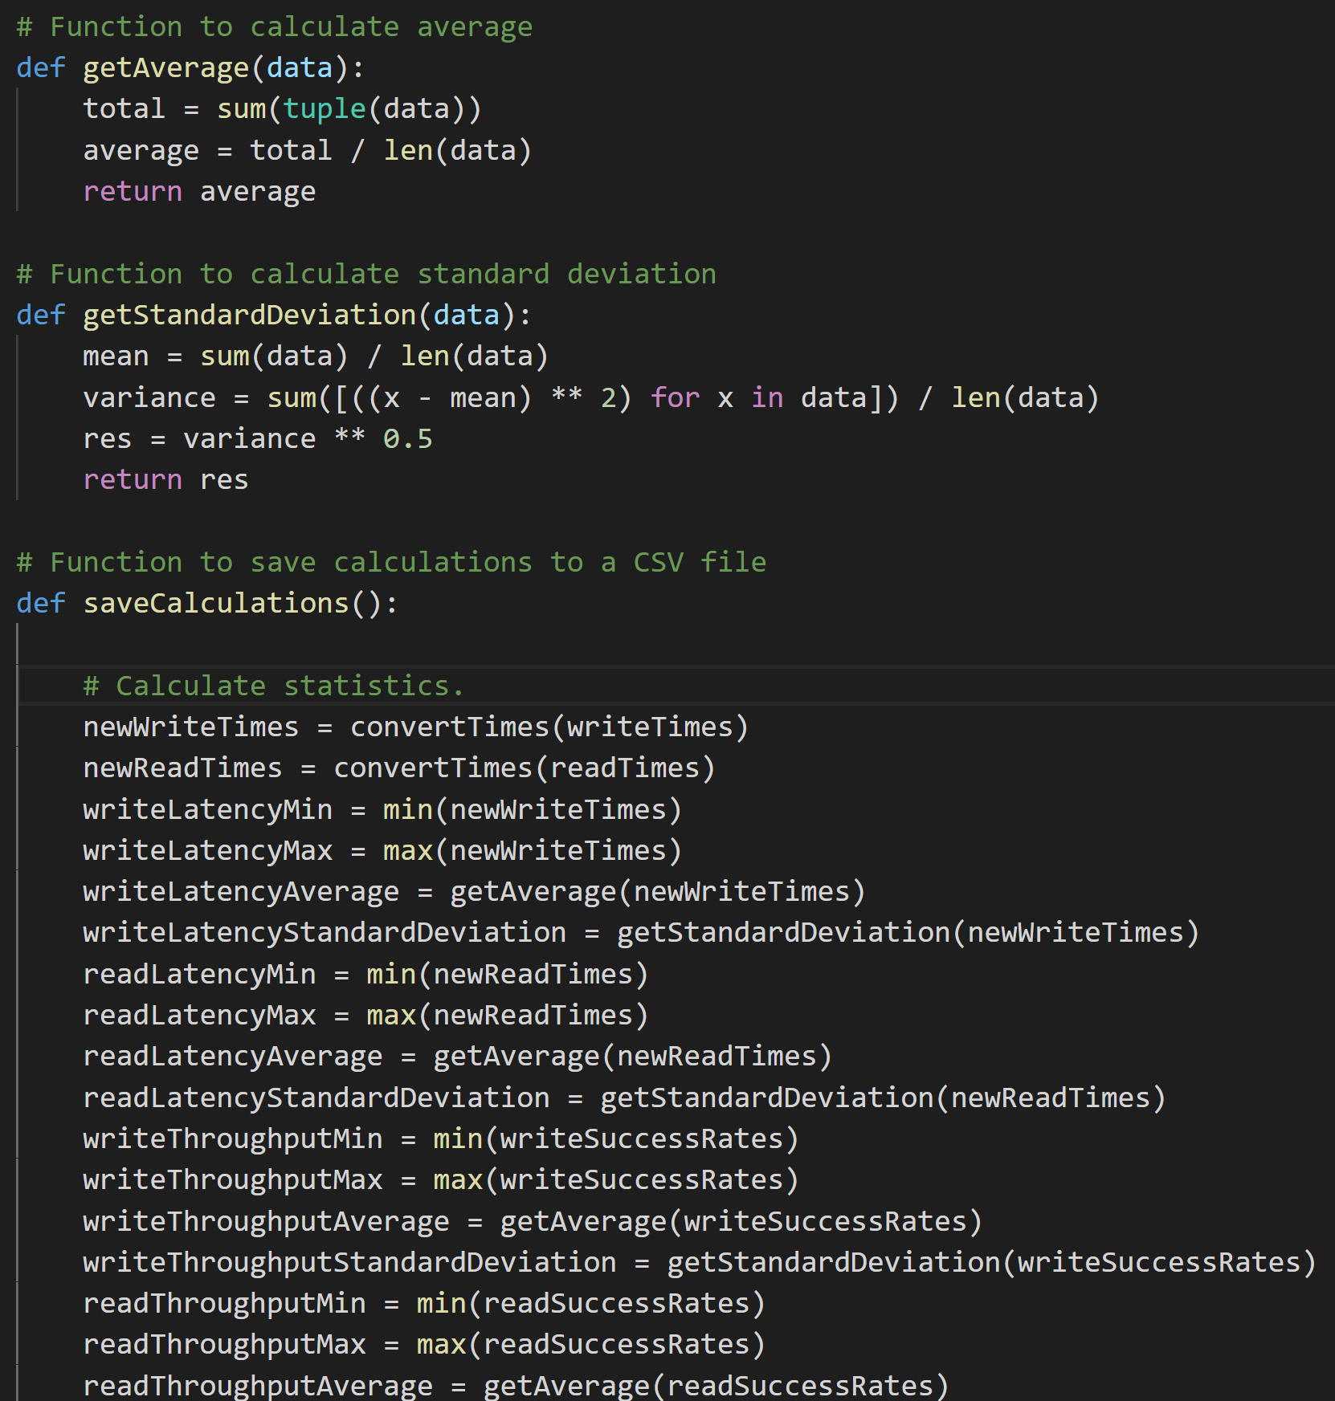
Code – calculateStatistics.py

Slide 7
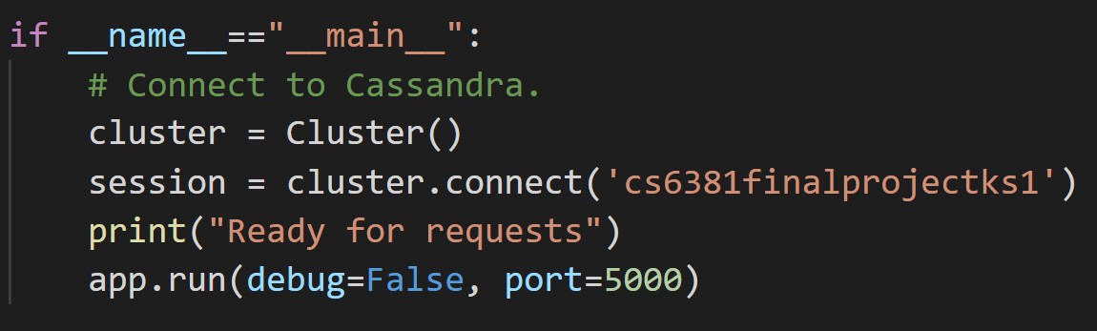
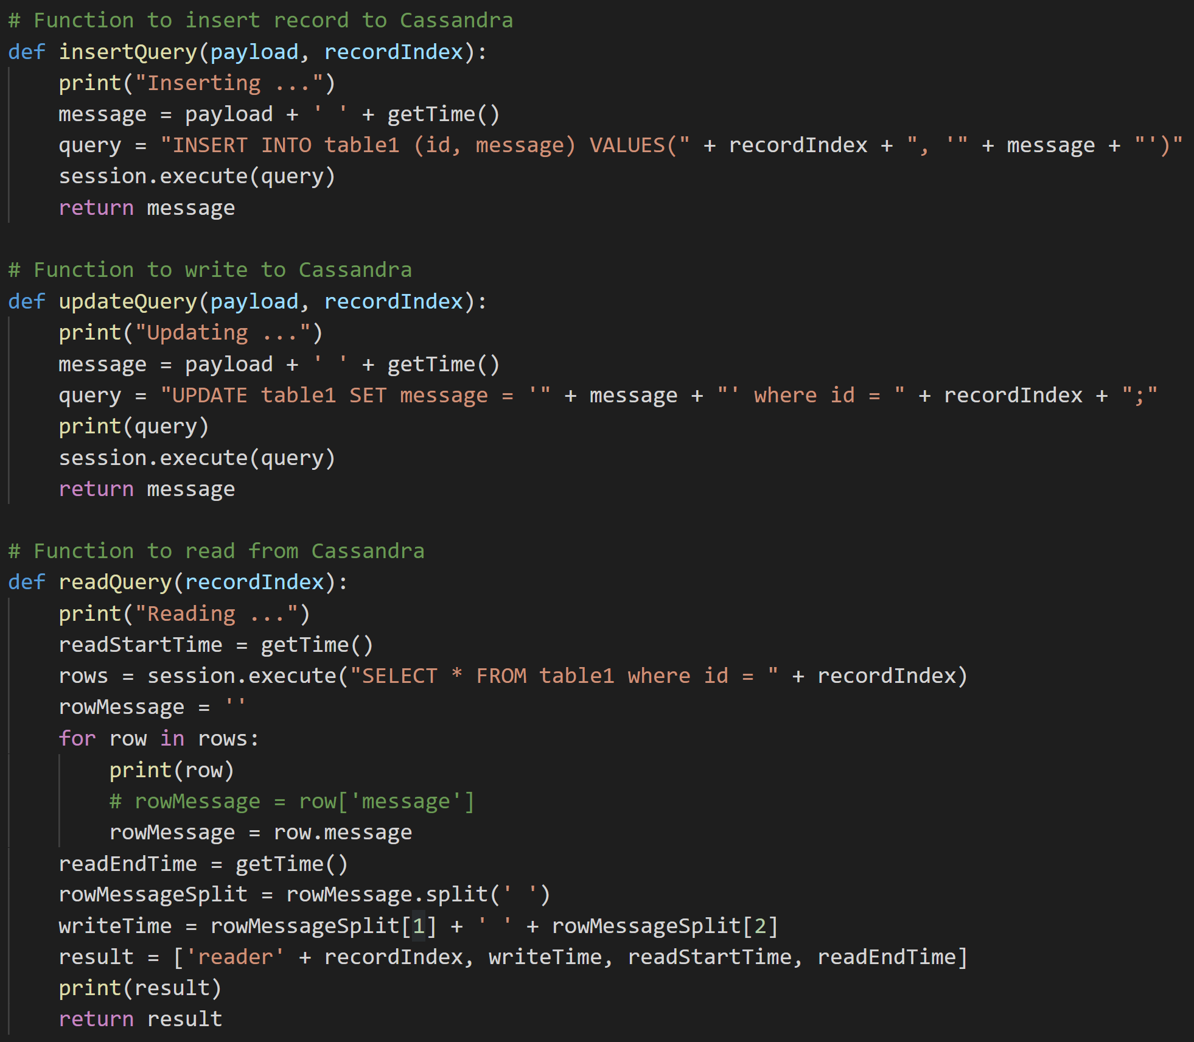
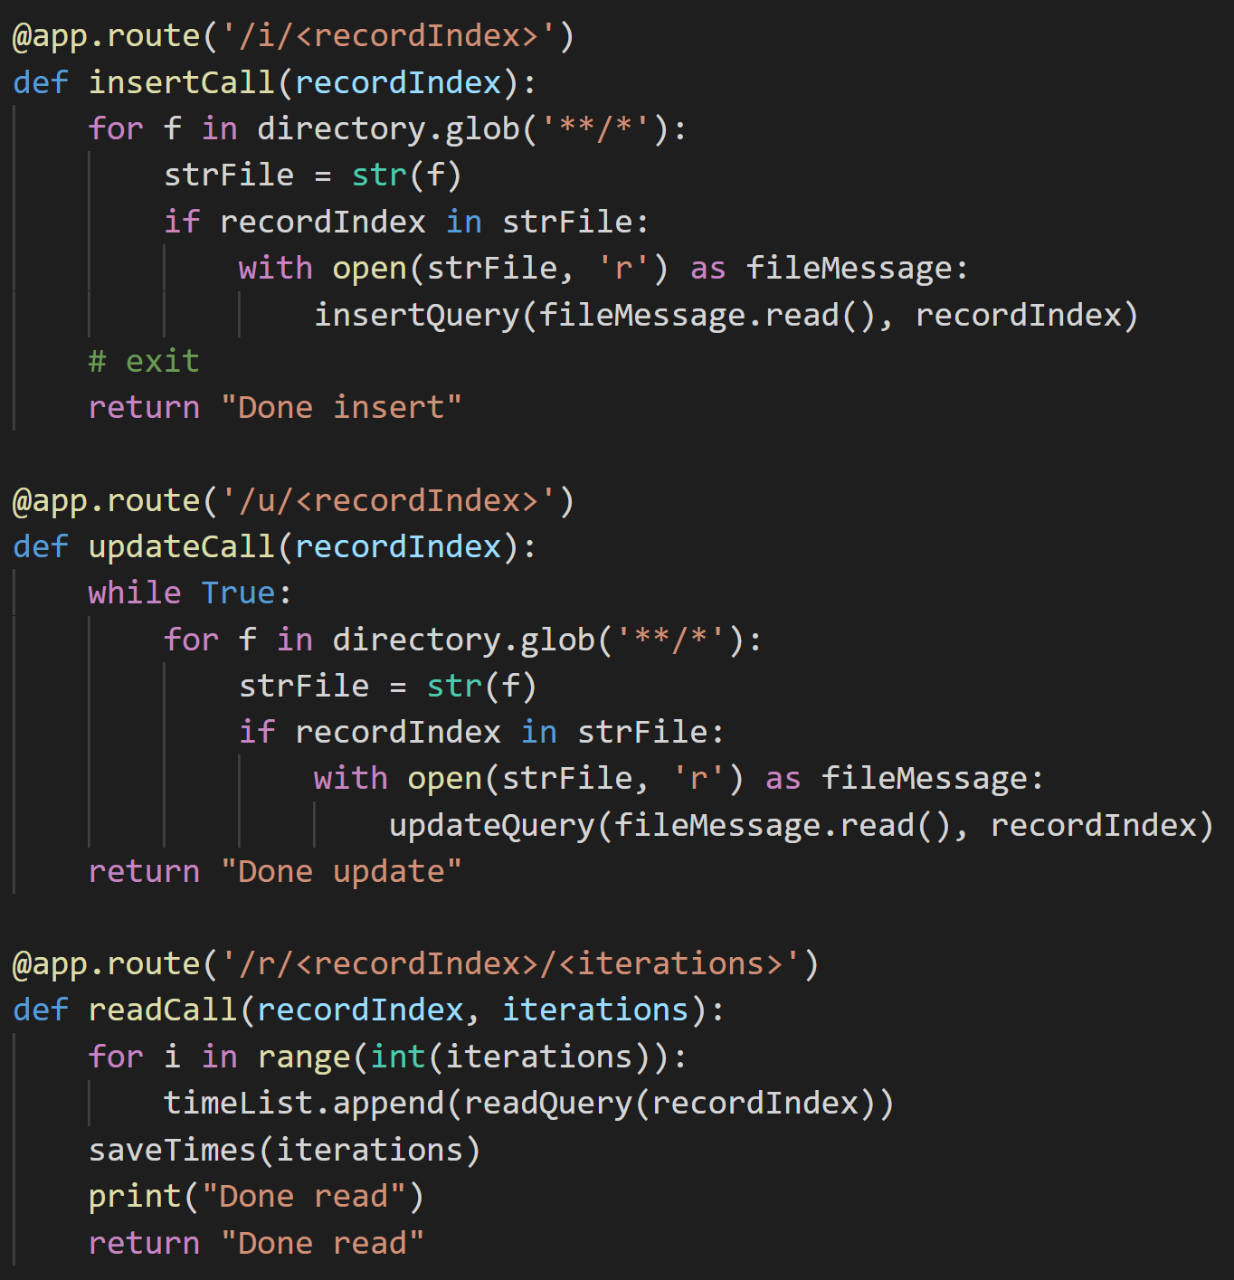
Code – capAnalysis.py

Slide 8
Setup
Spin up a Ubuntu VM (e. g. 18.04) and install Cassandra.
sudo apt install openjdk-8-jre-headless
cd /usr/lib/jvm/java-8-openjdk-amd64
sudo nano ~/.bashrc
Scroll to bottom of page and add in “JAVA_HOME=/usr/lib/jvm/java-8-openjdk-amd64”
Save the file using Ctrl + S on Windows or Command + S on Mac and then exit out using Ctrl + X on Windows or Command + X on Mac.
Reopen a new terminal.
echo $JAVA_HOME = See if above setup works.
sudo apt install curl
echo "deb http://downloads.apache.org/cassandra/debian 39x main" | sudo tee -a /etc/apt/sources.list.d/cassandra.sources.list
curl https://downloads.apache.org/cassandra/KEYS | sudo apt-key add -
sudo apt-get update
sudo apt-get install cassandra

Slide 9
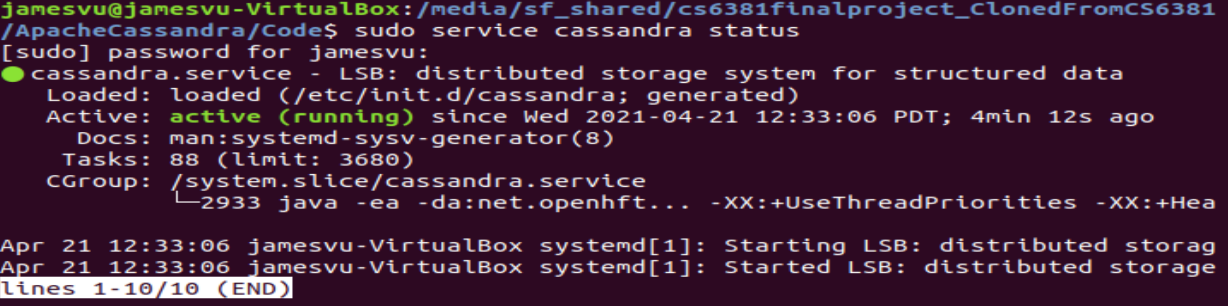
Setup
Run Cassandra.
Start: sudo service cassandra start
Check status: sudo service cassandra status (should see “active (running)”)
Stop: sudo service cassandra stop
If Cassandra stops after some time (e. g. Python application stops connecting to Cassandra), do the stop command then start command.

Slide 10
Setup
Create keyspace and table.
Open Cassandra terminal: cqlsh
Create keyspace (kind of like a schema): Create KeySpace {{keyspace name (e. g. cs6381finalprojectks1)}} with replication = {‘class’: ‘SimpleStrategy’, ‘replication_factor’: 3};
Show all keyspaces: SELECT * FROM system_schema.keyspaces;
Select keyspace: use {{your keyspace name}}
Create table: Create Table table1(id uuid Primary Key, message text);
Drop table: drop table {{table name (e. g. table1}}

Slide 11
Run Code
Get Time Differences CSV Data
Automatically
Navigate to the tests folder
Run a test using “./{{test name}}” (e. g. “./all.sh”).
Manually
Navigate to Code folder and run python3 cassandraRW.py accordingly to run writers/readers.
Run python3 calculateStatistics.py to calculate statistics of time differences.
You can measure hardware performance continuously by running hardwareMeasure.py, which will print the latest information.

Slide 12
Conditions Tested
cassandraRW.py (only 10 iterations instead of 10000 for time purposes)
Each test with writers writes to the database based on the experiment-specified character lengths: 128, 254, 512, 1024, 10000
Each reader and writer work independently (don’t have to wait for the other to finish to start running).
1 set x 1writerTest
1 set x 1readerTest
10 sets x 10writer1readerTest
10 sets x 1writer10readerTest
5 sets x 25writer25readerTest

Slide 13
Conditions Tested
capAnalysis.py (readers not ran concurrently due to seemingly unstable connection issues)
Run test in 1 of the following ways.
Way 1
Create table, run server, insert, and continuously update.
On each of 10 sets: Run readIteration.py with a parameter of 10 for 10 iterations.
Way 2
10 sets x 1insert1write10readTest
1000 not 10000 iterations for time purposes

Slide 14
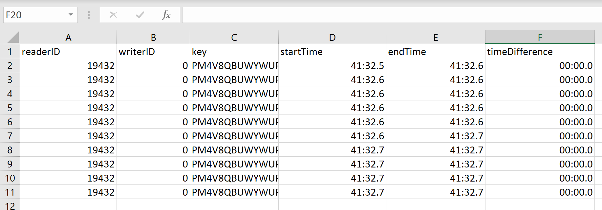
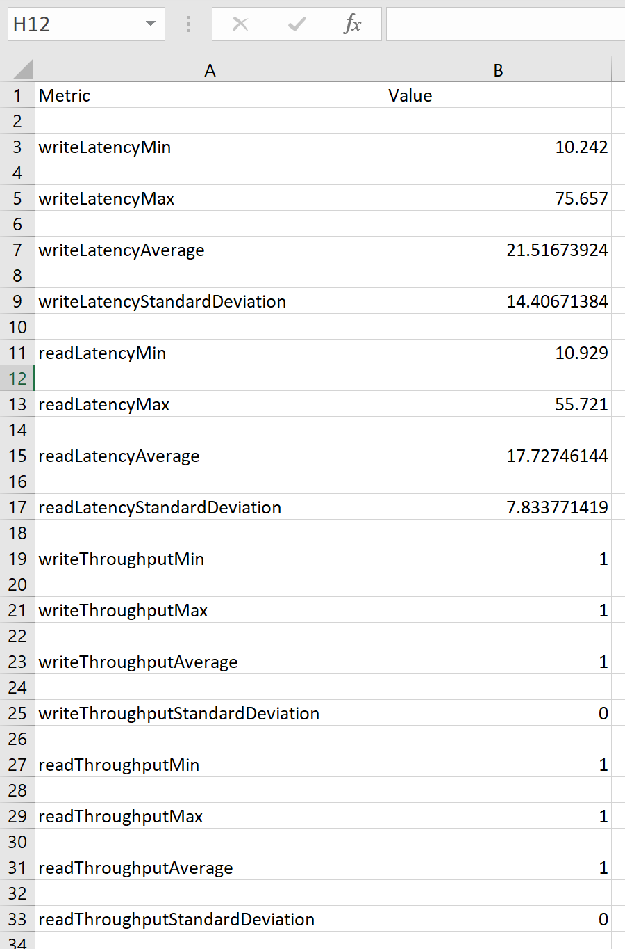
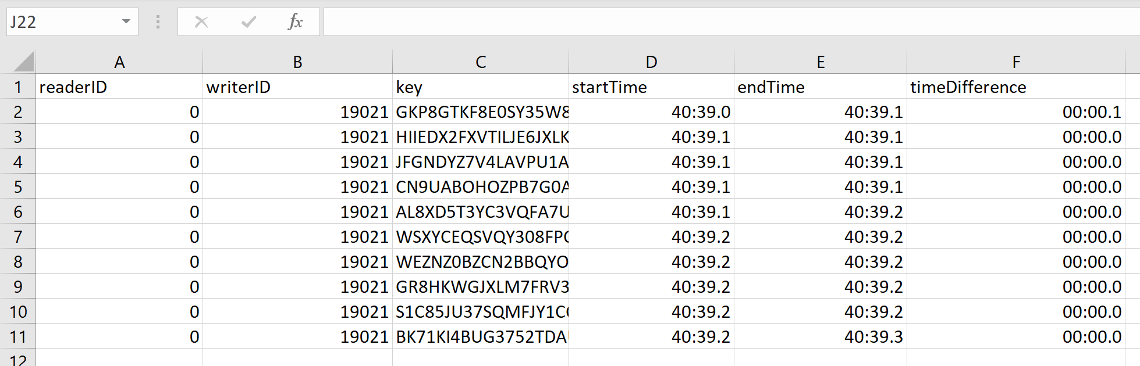
Result Format
Time Differences CSV for Reader
Calculations CSV
Time Differences CSV for Writer
* All timeDifference digits seem to be displayed in CSV file (e. g. on GitHub repo) but rounded in Excel.

Slide 15
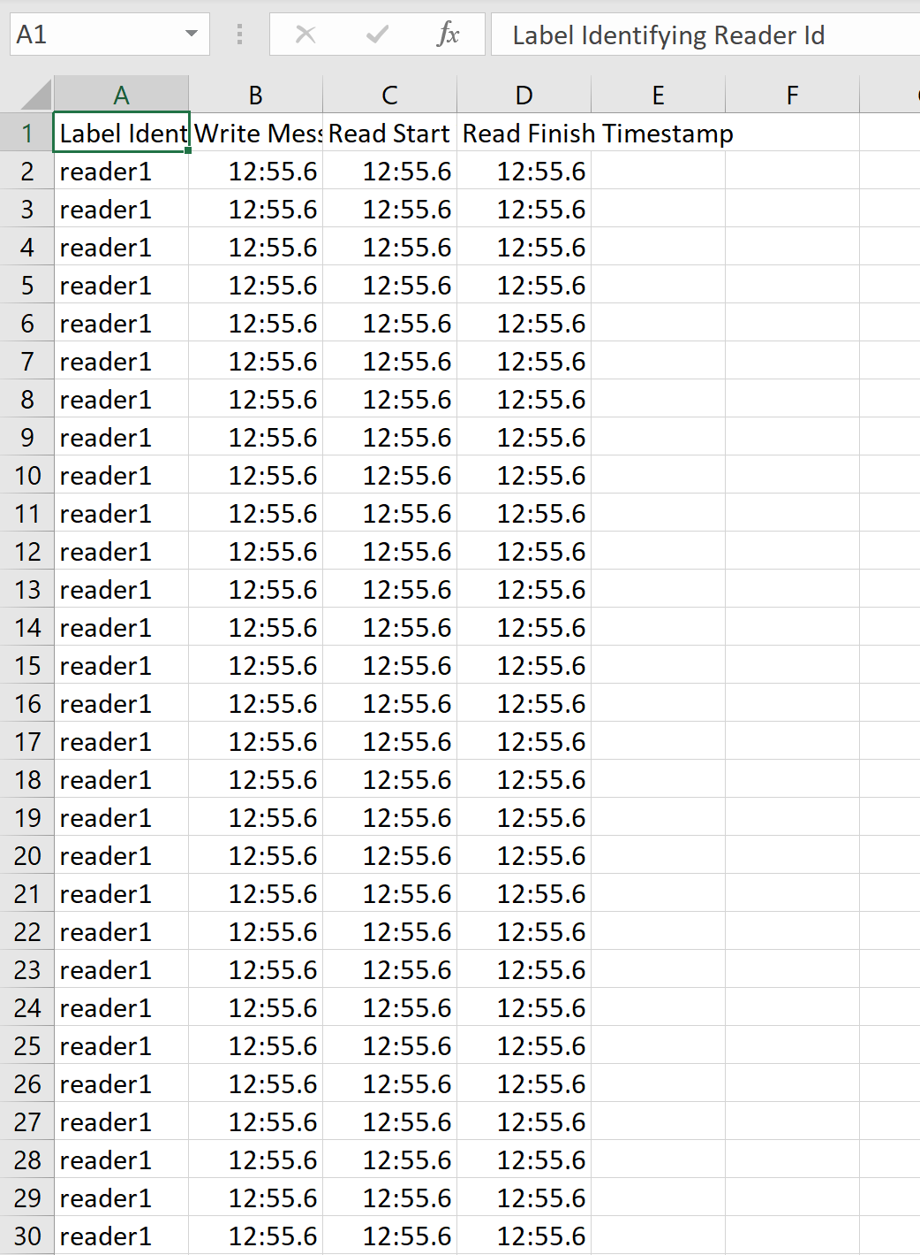
Result Format
Times for CAP Analysis

Slide 16
Base File - Basics
How many individual actors can connect to this system at one time? In our experiment trials, ~ 5 instances.
What license does it operate under? Apache License 2.0
How much must be paid to use this technology? Free
Does it have explicit enterprise support? DataStax uses Apache Cassandra and offers support.

Slide 17
Base File – Compatibility
OS
Ubuntu
Windows
Mac
Docker
Raspbian
CPU
Intel
AMD
ARM
Eiger
Language
Yes
Python
JavaScript
C
C++
C#
Java
Kotlin
Go
Ruby
Perl
Rust
Elixir
Maybe
PowerShell

Slide 18
Base File - Hardware Needs
 | CPU | RAM | Hard Disk Memory
Idle | 0.17142857142857143 | 93.39999999999999 | 10374848512.0
Max Observed Under Load A | 21.3 | 96.3 | 10375655424
Average Observed Under Load A | 7.466666666666666 | 94.08749999999999 | 10368999594.666666
Max Observed Under Load B | 19.0 | 95.7 | 10379653120
Average Observed Under Load B | 11.285714285714286 | 95.10000000000001 | 10376818688.0

Slide 19
Qualitative Data
Metric | Value
Use Case | For apps where data loss is unaffordable Write-heavy workloads
CAP Theorem Evaluation | Prioritizes Availability and Partitioning over Consistency
Database/Structure Hierarchy | Table, column, primary key. Open-source, distributed NoSQL database management system Keyspace, Partition, Table, Row, Column
Replication / Clustering Availability | Data replicated to nodes, across data centers. Nodes that fail get replaced fast. Linear scalability (add more nodes), synchronous/asynchronous replication. Multi-master Replication
Syntax/Query Language Support | Similar to MySQL (e. g. CREATE, INSERT, SELECT). Java, Python, Node, Go, C++ CQL (Cassandra Query Language)

Slide 20
Qualitative Data
Metric | Value
Centricity (data-centric or message-centric) | Data-centric (stores data)
Connection (machine-to-machine or point-to-point) | Point-to-point. Data replicated to nodes. Database can be used on the same computer.
Underlying Architecture (decentralized or hub-and-spoke) | Decentralized, no single place of failure
Protocol | Gossip Gossip allows data to spread to all group members.
Transport(s) | Ports are TCP.
Data Serialization | SQL is limited by table format and the need to change table rules when changing data structure. Data serialization alleviates this issue by treating the database as a file storage system that stores data in binary form in columns with unique ID’s. This allows queries to read fewer columns, thus dropping overhead. Apache Avro, a serialization library, allows the user to define JSON-based data structures in serialization.
Supports Queuing | Clustering order feature allows queries to be sorted according to their given parameter

Slide 21
Qualitative Data
Metric | Value
Data Type Representation | CQL (Cassandra Query Language) supports many native types (e. g. BLOB, BOOLEAN, DATE, FLOAT, INT, TEXT, TIMESTAMP, UUID, VARCHAR, etc.).
QoS Parameters | You can set the LIMIT or PARTITION LIMIT parameter to control how much data you get back with a SELECT query.
Supports Dynamic Discovery | Cassandra’s writing performance is greater than its reading performance.
Communication Patterns | Cassandra uses 7000 for cluster communication, 9042 for native protocol clients, and 7199 for JMX. Configure native procol and internode communication ports in Cassandra Configure File and JMX port in cassandra-env.sh. Ports are TCP.
Abstraction Layer | Cassandra uses CQL, which provides an abstraction layer to hide structure implementation. Casquatch is a database abstraction layer with code for streamlining Cassandra works that includes load balancing, connection pooling, and geo-redundancy and uses the concept of POJO instead of CQL.
Up-front Complexity | Decentralized. Data replicated to nodes. Setup not too difficult. The focus is on your project database design. Free, open source Setup can be not too difficult (e. g. on Ubuntu).
Large Implementations | Under 1 TB per node A row must fit 1 node. CQL has some limits: 2 GB max per column or blob, 48 characters max per table name, 65535 parameters max per query, etc.

Slide 22
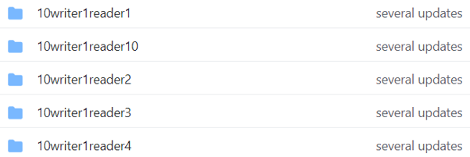
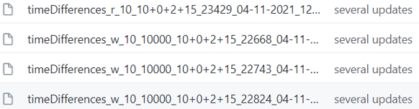
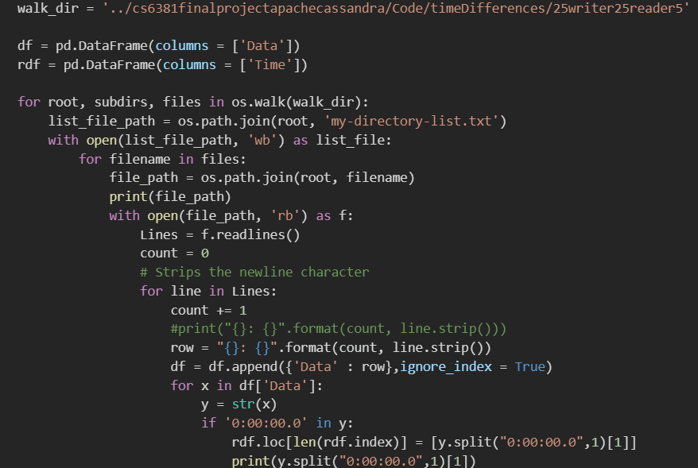

Collating Results in Python

Slide 23
Taking the average of each category of measurements. As seen below 9 iterations were benchmarked to obtain a sample size that would suffice. Each iterations ran multiple times. The results seen below are averages of the time difference notices when an action was taken in the Cassandra Database and a response was received. The data is in ms, eg 1800 is equivalent to 1.8 ms.

Slide 24
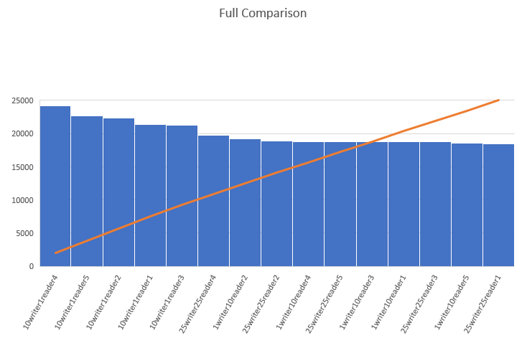
Story of the data.
Write operation response ms increase is negligible, the take away from this is that Cassandra is a great noSQL database for ‘write’ heavy applications.

Slide 25
CAP Times
Positive Regression line
Start read after write - Read after write

